Slide 1
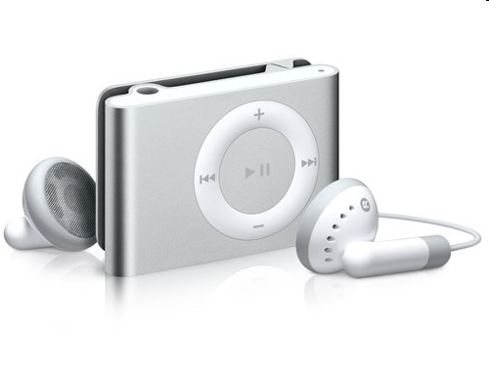
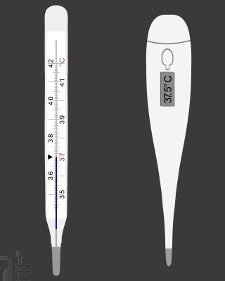
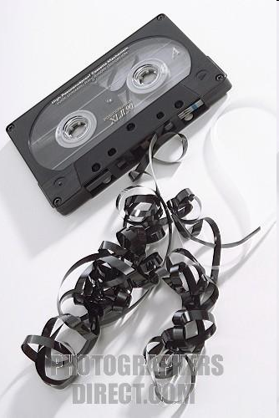
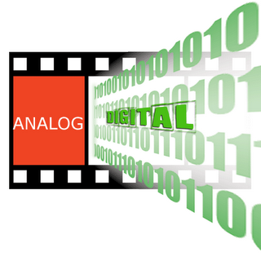
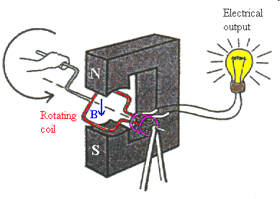
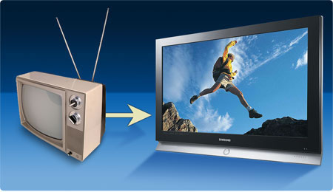

ANALOG TO DIGITAL HISTORY
1/13

Slide 2
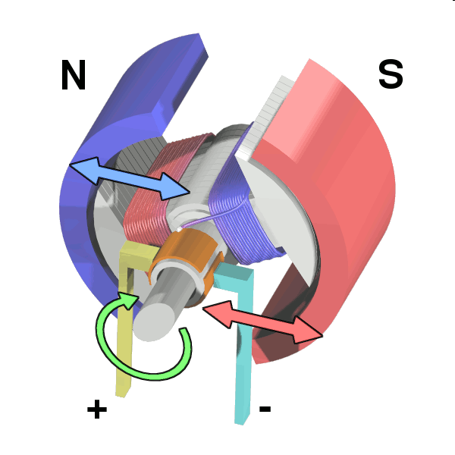
PREFACE
How we can process physical quantities from the nature like: temperature, pressure, water level, etc., without electric.
With electric, what is the way we do ?
 On most case, the fluctuation of a physical signal is sensed by a specified component known as Sensor, producing electric current with the same fluctuation.
Sensor
Physical signal
Electric
source
Electric current
2/13

Slide 3
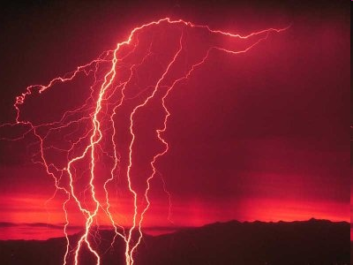
ADVANTAGE OF ELECTRIC SIGNAL
Easy to process: measure, display, store, transmit, amplify, etc.,
Easy to convert to other environment such as magnetic, optical.
Electric is widely used today
DISADVANTAGE
Affected by EMI (Electromagnetic Interference)
Sometimes cause danger to human
3/13

Slide 4
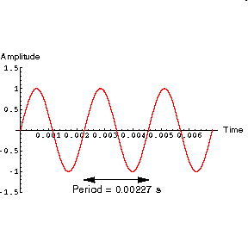
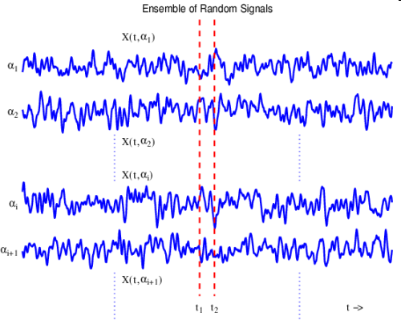
Signal classification
Non-random wave
Random signal
4/13

Slide 5
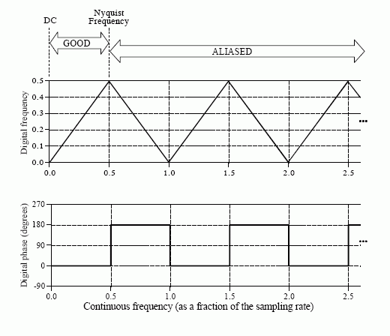
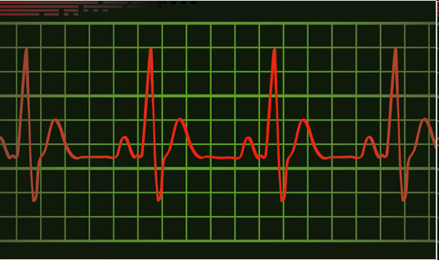
Signal classification
Ripple
Triangle and square pulses
5/13

Slide 6
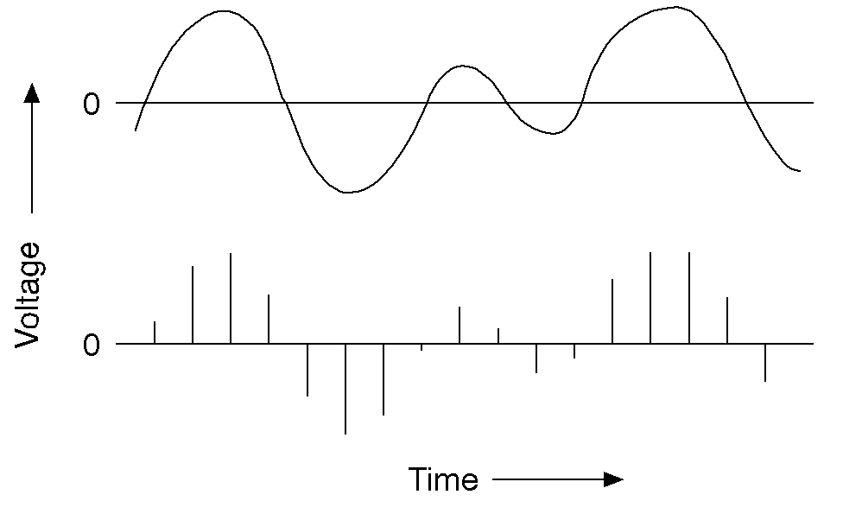
Signal classification
Continuous signal
Discrete Signal
6/13

Slide 7
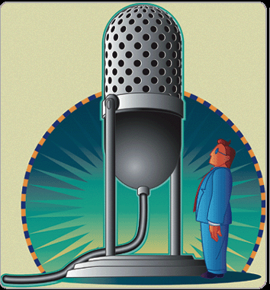
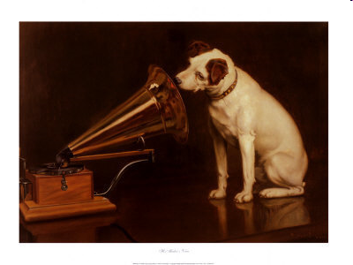
Comments
 Most signals from the nature is continuous with random form.
 Original raw signal often has redundancy.
We can convert the changing of
natural signal into a similar progress
of electric quantity, this process is
known as Analog.
7/13

Slide 8
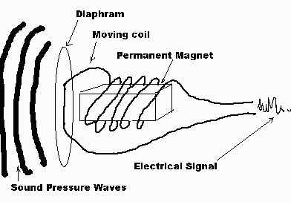
Sound Signal is Converted to Electrical Signal
8/13

Slide 9
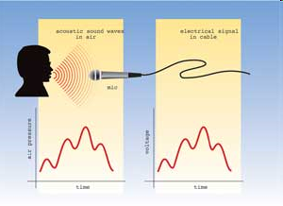
Analog modeling
9/13

Slide 10
Analog to Digital Conversion
 Analog signals can be digitalized according to Nyquist – Shannon sampling theorem.
Input
Signal
Band
limited
Filter
Sampling
Quantization
Encoding
u
s(t)
Coding
01101…
0
t
Analog
Signal
Discrete-time
Signal S_{n}t
Digital signal
10/13

Slide 11
u
u
s(t)
s_{i}
0
t
0
t
Input signal with
definite frequency
Sampling
Sample & hold circuit
F_{s} ≥ 2.F_{max}
u
.
.
0000 0001 0100 0110…
.
4
3
2
1
0
t
Quantization
Encoding
Linear, Non-linear, Adaptive linear quantization
11/13

Slide 12
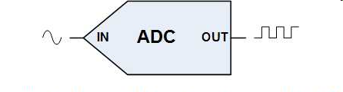
ANALOG SIGNAL
DIGITAL SIGNAL
ELECTRICAL SYMBOL FOR ANALOG TO DIGITAL CONVERTER (ADC)
12/13

Slide 13
Digital versus Analog
DIGITAL Noise: Transmission: Data Storage & Resources Sharing: Bandwidth: Flexibility: Signal processing: Power consumption: Interconnection: QoS: | ANALOG Noise: Transmission: Data Storage & Resources Sharing: Bandwidth: Flexibility: Signal processing: Power consumption: Interconnection: QoS:
13/13

Slide 14
Digital versus Analog
DIGITAL Noise: better, easier Transmission: flexible, more secure Data Storage & Resources Sharing: more effective Bandwidth: using less bandwidth Flexibility: more flexible Signal processing: more powerful Power consumption: less Interconnection: easier QoS: better | ANALOG Noise: much noisy Transmission: not secure Data Storage & Resources Sharing: not effective Bandwidth: using more bandwidth Flexibility: Not flexible Signal processing: limited Power consumption: more Interconnection: QoS:
13/13

